Slide 1
Matrix Time
Data Structures Week 1
In the system of matrix clocks, the time is represented by a set of n x n matrices of non-negative integers.
A process p_{i} maintains a matrix mt_{i}[1..n, 1..n] where, mt_{i} [i, i] denotes the local logical clock of p_{i} and tracks the progress of the computation at process p_{i}.
mt_{i}[i, j] denotes the latest knowledge that process p_{i} has about the local logical clock, mt_{j}[j, j], of process p_{j}. Mt[i,*] is vector vt_{i}
mt_{i}[j, k] represents the knowledge that process p_{i} has about the latest knowledge that p_{j} has about the local logical clock, mt_{k}[k, k], of p_{k} .
The entire matrix mt_{i} denotes p_{i}’s local view of the global logical time.

Slide 2
Matrix Time
Data Structures Week 1
Process p_{i} uses below rules to update its clock:
Rule 1 : Before executing an event, process p_{i} updates its local logical time as follows:
mt_{i}[i, i] := mt_{i}[i, i] +d

Slide 3
Matrix Time
Data Structures Week 1
Rule 2: Each message m is piggybacked with matrix time mt. When p_{i} receives such a message (m,mt) from a process p_{j}, then p_{i} executes the below sequence:
  Update its global logical time as follows:
    (a) 1 ≤ k ≤ n : mt_{i}[i, k] := ?
    (b) 1 ≤ k, l ≤ n : mt_{i}[k, l] := max(mt_{i}[k, l], mt[k, l])
  Execute Rule 1.
  Deliver message m

Slide 4
Matrix Time
Data Structures Week 1
Process p_{i} uses below rules to update its clock:
Rule 1 : Before executing an event, process p_{i} updates its local logical time as follows:
mt_{i}[i, i] := mt_{i} [i, i] + d (d > 0)
Rule 2: Each message m is piggybacked with matrix time mt. When p_{i} receives such a message (m,mt) from a process p_{j}, then p_{i} executes the below sequence:
  Update its global logical time as follows:
    (a) 1 ≤ k ≤ n : mt_{i}[i, k] := max(mt_{i}[i, k], mt[j, k]) (That is, update its row mt_{i}[i,∗] with the p_{j}’s row in the received timestamp, mt.)
    (b) 1 ≤ k, l ≤ n : mt_{i}[k, l] := max(mt_{i}[k, l], mt[k, l])
  Execute Rule 1.
  Deliver message m

Slide 5
Basic Properties of Matrix Time
Data Structures Week 1
Vector mt_{i}[i, .] contains all the properties of vector clocks.
In addition, matrix clocks have the following property:
  min_{k} (mt_{i}[k, i]) ≥ t ⇒ process p_{i} knows that every other process p_{k} knows that p_{i}’s local time has progressed till t.
If this is true, it is clear that process p_{i} knows that all other processes has received p_{i} ‘s msg sent at t and hence can discard the msg.
In many applications, this implies that processes will no longer require from p_{l} certain information (it might be holding information until all processes are updated about some msg from p_{l})and can use this fact to discard obsolete information.

Slide 6
Matrix Time Vs. Vector Time
Data Structures Week 1
Matrix time is useful in settings such as maintaining a distributed dictionary or a distributed database.
Updates are streamed continuously across the sites.
Each site has to know when an update message needs to be no longer stored.
Matrix time can tell local sites when to discard old messages.

Slide 7
A Distributed Program in Execution
  How can causal order among messages be guaranteed? Read about it from An Efficient Causal Order Algorithm for Message Delivery in Distributed System, Jangt, Park, Cho, and Yoon

Slide 8
Global State of a Distributed System
Cant stop the process and see the global snapshot and neither can we synchronise all the systems and ask them to take a snapshot at a particular instant.
Not necessary a state the system has visited but is one state that the system could have visited
Application: Check Pointing Recovery, Deadlock needs understanding current state to measure if a true deadlock.
Issues: We need to know both node and channel states as some msgs might be in transit
Assumption: System can not be stopped to take global state. Also no global clock to do the same.

Slide 9
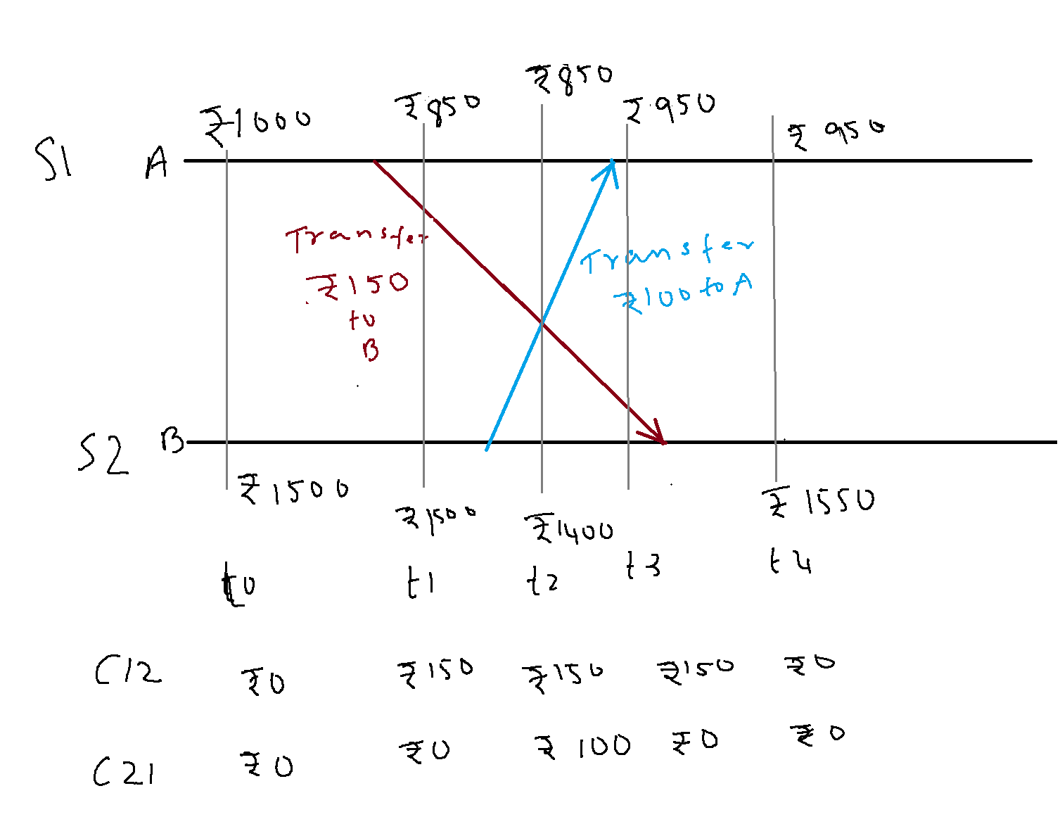
Global States and Snapshots
Consider the distributed execution shown above.

Slide 10
Global States and Snapshots
If the state of the account A is recorded at time t0 and the state of account B and that of the channels C12 and C21 are recorded at t2, what is the total money in the system?

Slide 11
Global States and Snapshots
Initially 1000+1500=2500
At check point 1000(A) +1400(B)+150(C₁₂)+100(C₂₁)= 2650
If this state is used for checkpointing, then there is trouble!
An extra 150 Rs !!!.

Slide 12
Global State of a Distributed System
One can think of the collection of local states as the global state.
Recall that the local state of a process, P_{i}, is the contents of the processor registers, stack, local memory, etc.
The state of a channel is the set of messages in transit in the channel.
Events lead to changes in the state of local process(es).

Slide 13
Global States and Snapshots
Recording the global state of a distributed system on-the-fly is an important paradigm.
The lack of globally shared memory, global clock and unpredictable message delays in a distributed system make this problem non-trivial.
Building on the definition consistent global states we discuss issues to be addressed to obtain consistent distributed snapshots.
Then several algorithms to determine on-the-fly such snapshots are presented for several types of networks.

Slide 14
Global State of a Distributed System
At any instant the state of a process Pi denoted by LS_{i}, is a result of the sequence of all events executed by p_{i} upto that instant. State of a Channel C_{ij} is denoted as SC_{ij}
The msgs in transit on the channel C_{ij} are denoted as
SC_{ij} ={m_{ij} | send (m_{ij}) ∈ LS_{i} and rec(m_{ij}) ∉LS_{j}}
To formalize, let LS^{x}_{i} denote the local state of process P_{i} after the occurrence of all events until event e^{x}_{i}
  LS⁰_{i} is the initial state of P_{i}

Slide 15
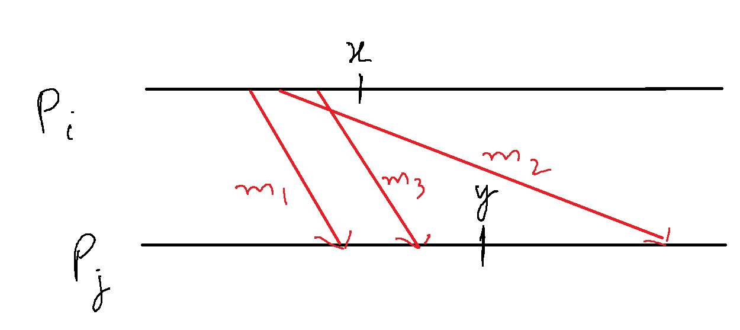

Global State of a Distributed System
We use the above to capture the state of a channel C_{ij}, denoted SC^{x,y}_{i,j} as follows.
  SC^{x,y}_{i,j} = {m_{ij} | send(m_{ij}) <= LS^{x}_{i} and recv(m_{ij}) LS^{y}_{j}}
In words, the state of SC^{x,y}_{i,j} denotes all messages that have been sent by P_{i} up to event e^{x}_{i} and not received by P_{j} up to event e^{y}_{j}.

Slide 16
Conditions for Consistent Global States
The global state of a distributed system is a collection of the local states of the processes and the channels.
Notationally, global state GS is defined as,
  GS = { U_{i}LS_{i} , U_{i,j} SC_{ij}}
A global state GS is a consistent global state iff it satisfies the following two conditions :
C1: send(m_{ij})∈ LS_{i} ⇒ m_{ij} ∈ SC_{ij} ⊕ rec(m_{ij})∈LS_{j}. (⊕ is the Exclusive-OR operator)
C2: send(m_{ij})∉ LS_{i} ⇒ m_{ij} ∉ SC_{ij} Ʌ rec(m_{ij}) ∉ LS_{j}.

Slide 17
Conditions for Consistent Global States
A global state GS is a consistent global state iff it satisfies the following two conditions :
C1: send(m_{ij})∈ LS_{i} ⇒ m_{ij} ∈ SC_{ij} ⊕ rec(m_{ij})∈LS_{j}. (⊕ is the Exclusive-OR operator)
C1 states the law of conservation of messages.
  Every message that is recorded as sent in the local state of some process is either captured in the state of the channel or is captured in the local state of the receiver.
C2: send(m_{ij})∉ LS_{i} ⇒ m_{ij} ∉ SC_{ij} Ʌ rec(m_{ij}) ∉ LS_{j}.
C2 states that for every cause there is an effect.
  If a message is not recorded as sent in the local state of a process P_{i}, then the message cannot be included in the state of the channel C_{ij} or be captured as received by P_{j}.

Slide 18
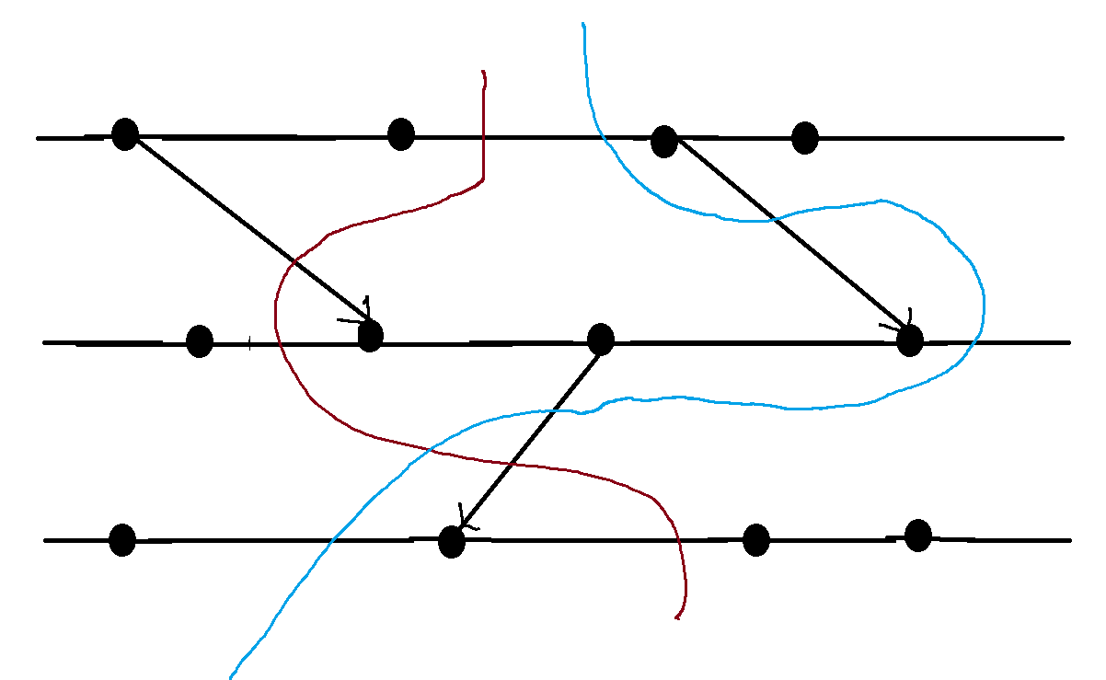
Interpretation in terms of cuts
A cut in a space-time diagram is a line joining an arbitrary point on each process line that slices the space-time diagram into a PAST and a FUTURE.
A consistent global state corresponds to a cut in which every message received in the PAST of the cut was sent in the PAST of that cut.
Such a cut is known as a consistent cut.

Slide 19
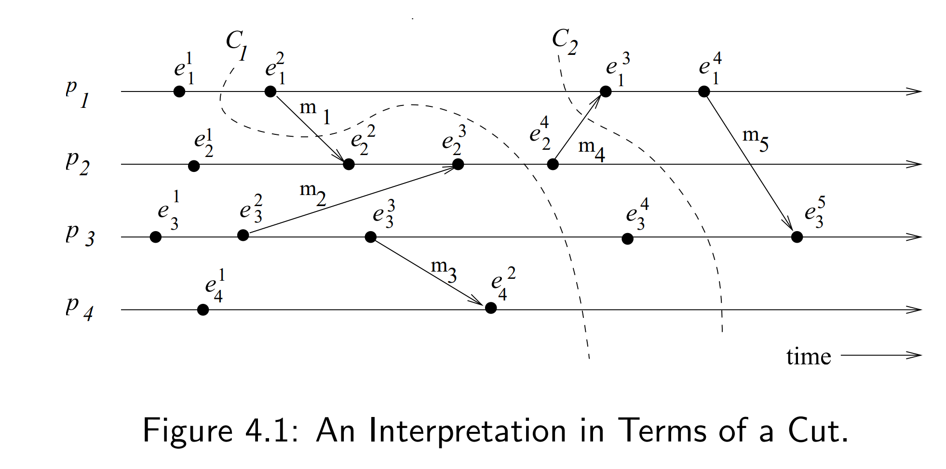
Interpretation in terms of cuts – Example
Cut C₁ is inconsistent because message m₁ is flowing from the FUTURE to the PAST.
Cut C₂ is consistent and message m₄ must be captured in the state of channel C₂₁.

Slide 20
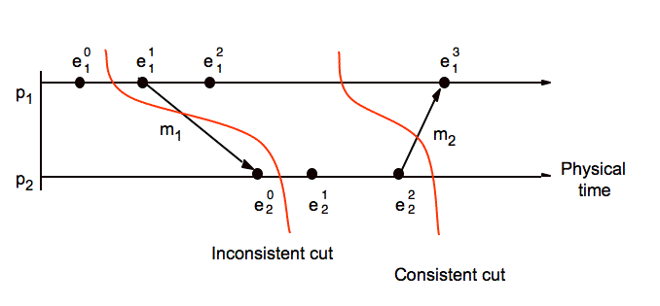
Consistent and Inconsistent Cut

Slide 21
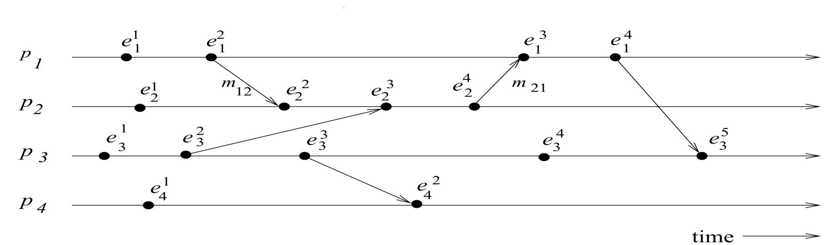
Example
Which global states are consistent?
{LS¹₁, LS³₂, LS³₃, LS²₄}
{LS²₁, LS⁴₂, LS⁴₃, LS²₄}
{LS²₁, LS¹₂, SC²²₁₂, LS³₃, LS²₄}
  SC^{x,y}_{i,j} = {m_{ij} | send(m_{ij})<= LS^{x}_{i} and recv(m_{ij}) LS^{y}_{j}}

Slide 22
Example
Which global states are consistent?
{LS¹₁, LS³₂, LS³₃, LS²₄} -inconsistent
{LS²₁, LS⁴₂, LS⁴₃, LS²₄} - inconsistent
{LS²₁, LS¹₂, SC²²₁₂, LS³₃, LS²₄} - inconsistent
  SC^{x,y}_{i,j} = {m_{ij} | send(m_{ij})<= LS^{x}_{i} and recv(m_{ij}) LS^{y}_{j}}

Slide 23
Difficulty of Taking a Snapshot
Issue 1: How to distinguish between the messages to be recorded in the snapshot from those not to be recorded.
  Any message that is sent by a process before recording its snapshot, must be recorded in the global snapshot (from C1).
  Any message that is sent by a process after recording its snapshot, must not be recorded in the global snapshot (from C2).
Issue 2: How to determine the instant when a process takes its snapshot.
    A process p_{j} must record its snapshot before processing a message m_{ij} that was sent by process p_{i} after recording its snapshot.

Slide 24
A Distributed Program in Execution
Let us now model message delivery.
Several ways are possible
  Non-FIFO : Message can be reordered in transit
  FIFO : Messages are NOT reordered in transit.
  Causal : Slightly stronger than FIFO. Messages destined for the same destination are not reordered. In symbols,
  for any two messages m_{ij} and m_{kj},
  if send(m_{ij}) → send(m_{kj}) then recv(m_{ij}) → recv(m_{kj}).
  Causal degenerates to FIFO when sent from same process.
  FIFO ⊂ Non-FIFO.

